Slide 1
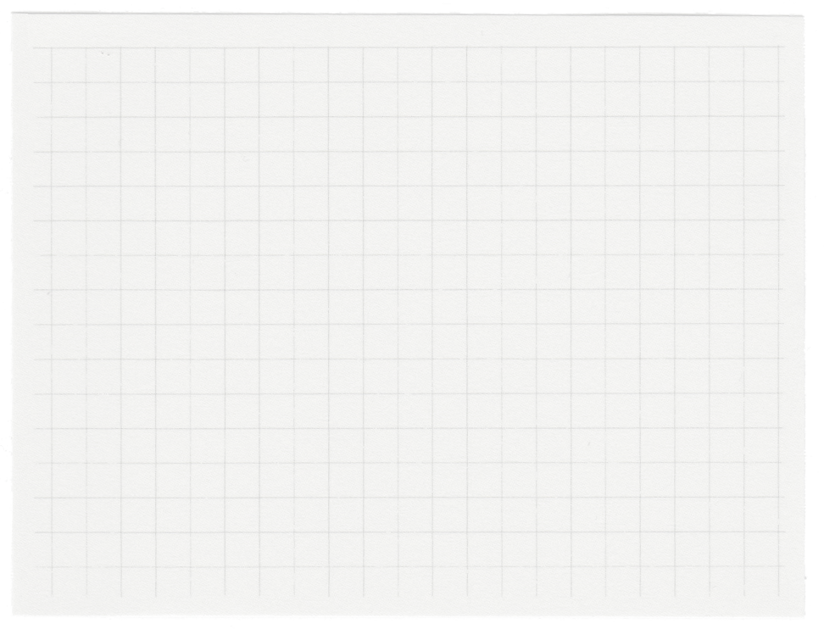
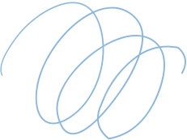
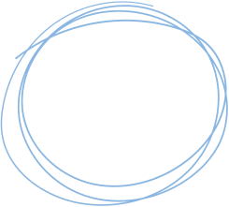

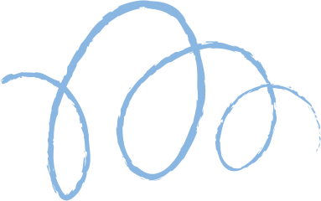









Social Media Application
Presented by Group-10
AP21110011397-V.Divyambica
AP21110011405-P.Harika
AP21110011412-R.Akanksha
AP21110011413-T.Sireesha
1

Slide 2
Contents
Introduction
Project Timeline
Description
Technologies used
Step-By-step process
Interface
Conclusion
2

Slide 3

Introduction
Our project aims to develop a state-of-the-art social media application that meets the evolving needs of users in today's digital landscape. With social media platforms playing a pivotal role in reshaping communication and fostering connections, our objective is to create a cutting-edge platform that offers innovative solutions and enhances user experiences. Key features of our application include a dynamic and engaging interface for networking and content sharing, coupled with a user-friendly design that prioritizes simplicity and accessibility.
3

Slide 4
Project Timeline
CLASS DIAGRAM, ER DIAGRAM​
SRS DOCUMENT
DATA FLOW DIAGRAM​
USE CASE DIAGRAM​
ACTIVITY DIAGRAM
CODING​
TESTING​
UPLOAD ON GITHUB​
4

Slide 5
Description
Frontend Development: Frontend development is all about building the parts of a website or web application that users interact with directly. It's like the front door of a house – it's what people see and use.​
Tools and Technologies:​
HTML​
CSS​
JavaScript​
ReactJS​
​
Backend Development: Backend development is like the engine of a car – it's what powers everything behind the scenes. It handles the data and logic that make a website or web application work.​
Tools and Technologies:​
Node.js​
Express.js​
Databases​​
​
5

Slide 6





Technologies Used
Front-end:
Back-end:
Databases
JAVASCRIPT
REACT JS
NEXT JS
BOOTSTRAP
MONGODB
NodeJS,
ExpressJS​
6

Slide 7
STEP BY STEP PROCESS​
Sign Up
Login
Profile Creation
Connecting with Others
Content Creation
Interacting with Content
7

Slide 8
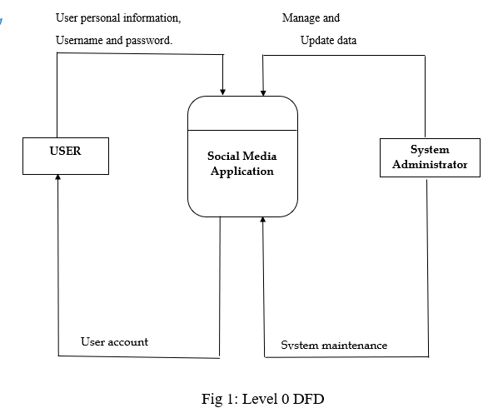
DATA FLOW DIAGRAM
8

Slide 9
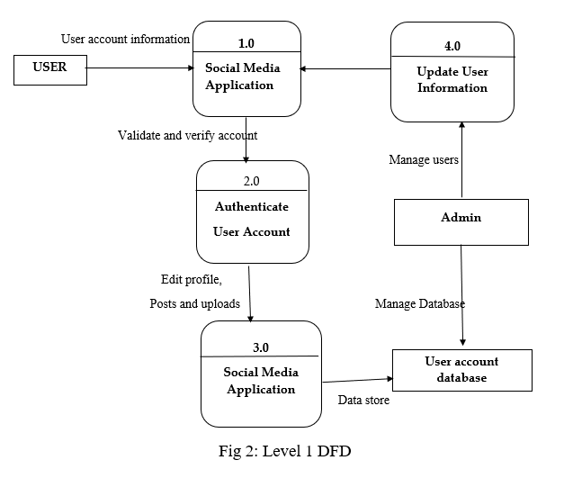
Level-1
9

Slide 10
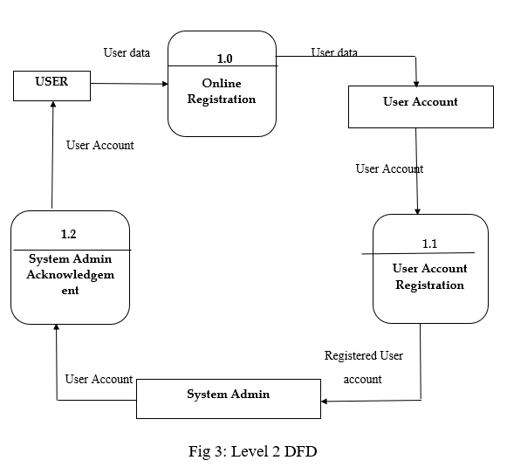
Level-2
10

Slide 11
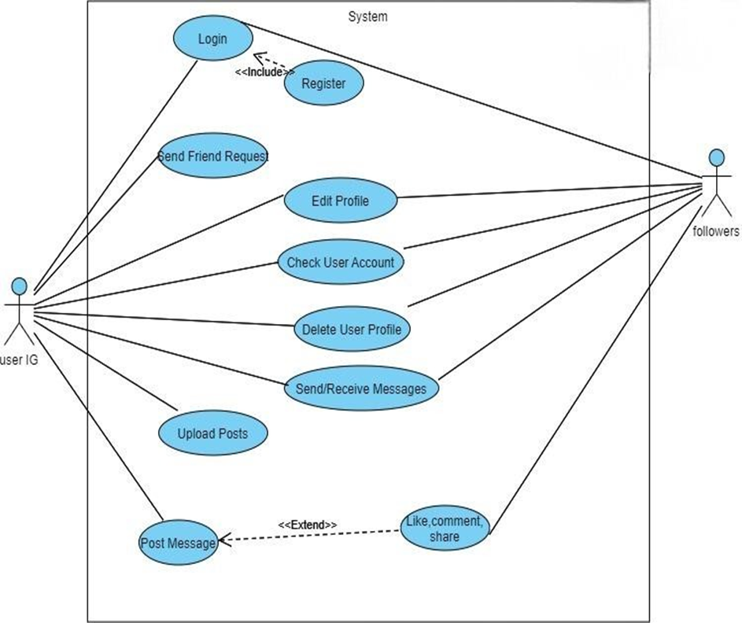
USE CASE DIAGRAM
11

Slide 12
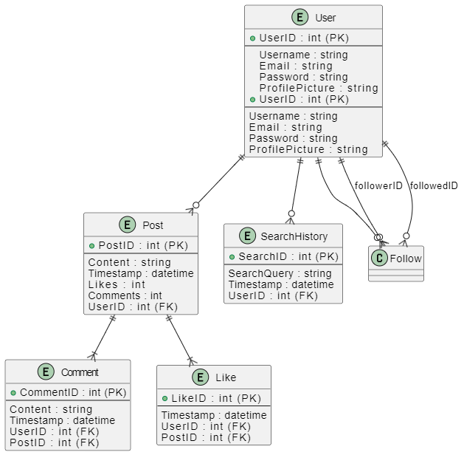
ER DIAGRAM
12

Slide 13
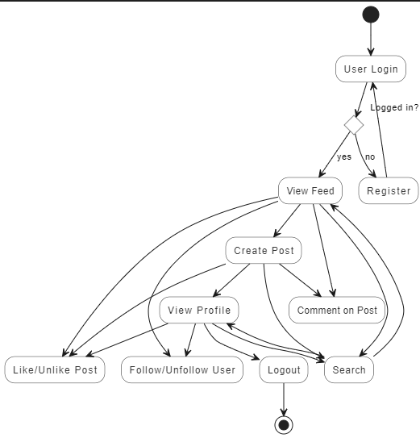
ACTIVITY DIAGRAM
13

Slide 14
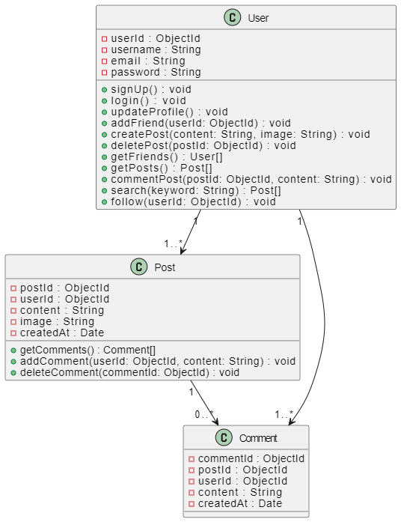
CLASS DIAGRAM
14

Slide 15
Functional Requirements
User Registration and Authentication
Profile Management
Social Interaction (Follow and Unfollow)
Content sharing (post)
Like and Comment
Search
15

Slide 16
Non Functional Requirements
Security
Performance
Scalability
Usability
Reliability
16

Slide 17
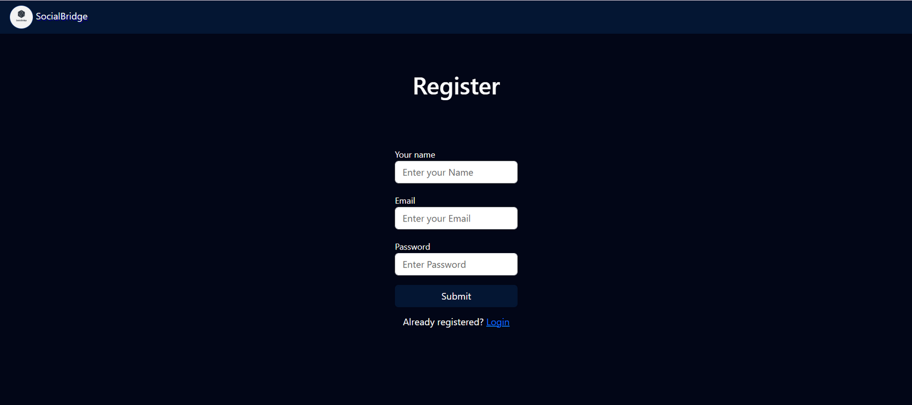
Register Page
17

Slide 18
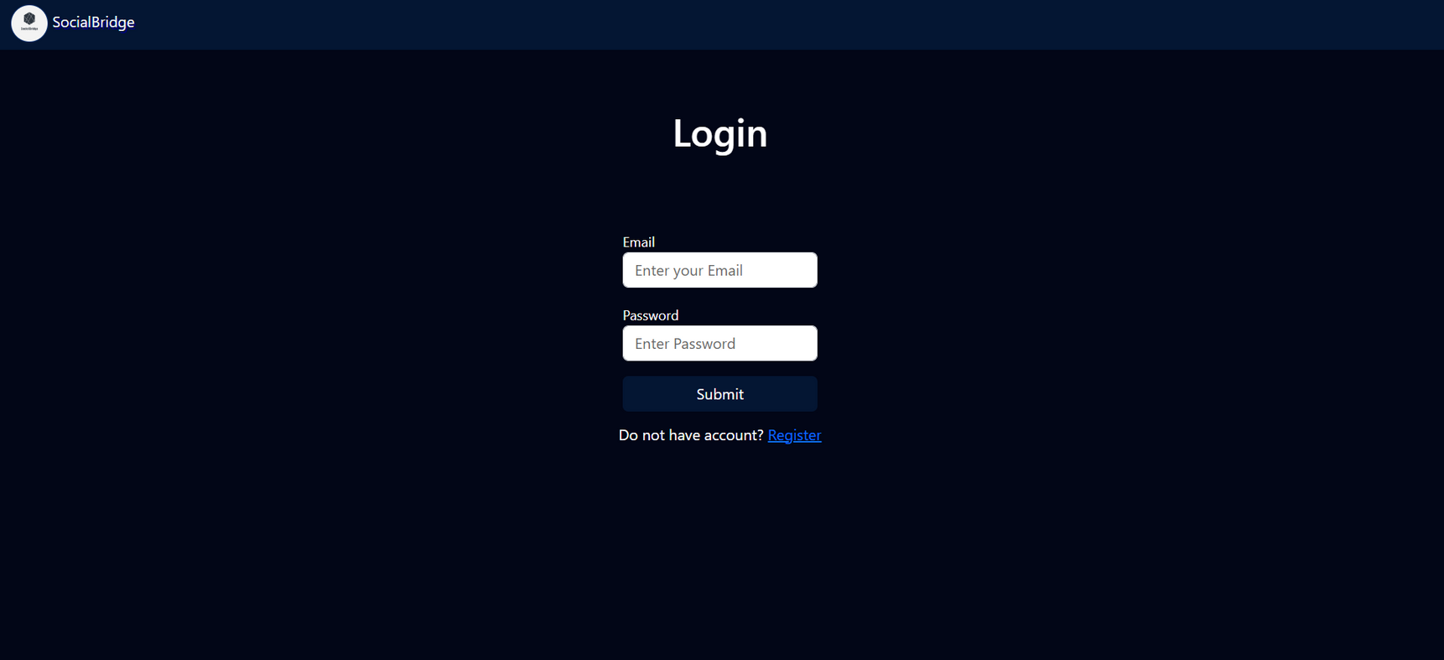
Login Page
18

Slide 19

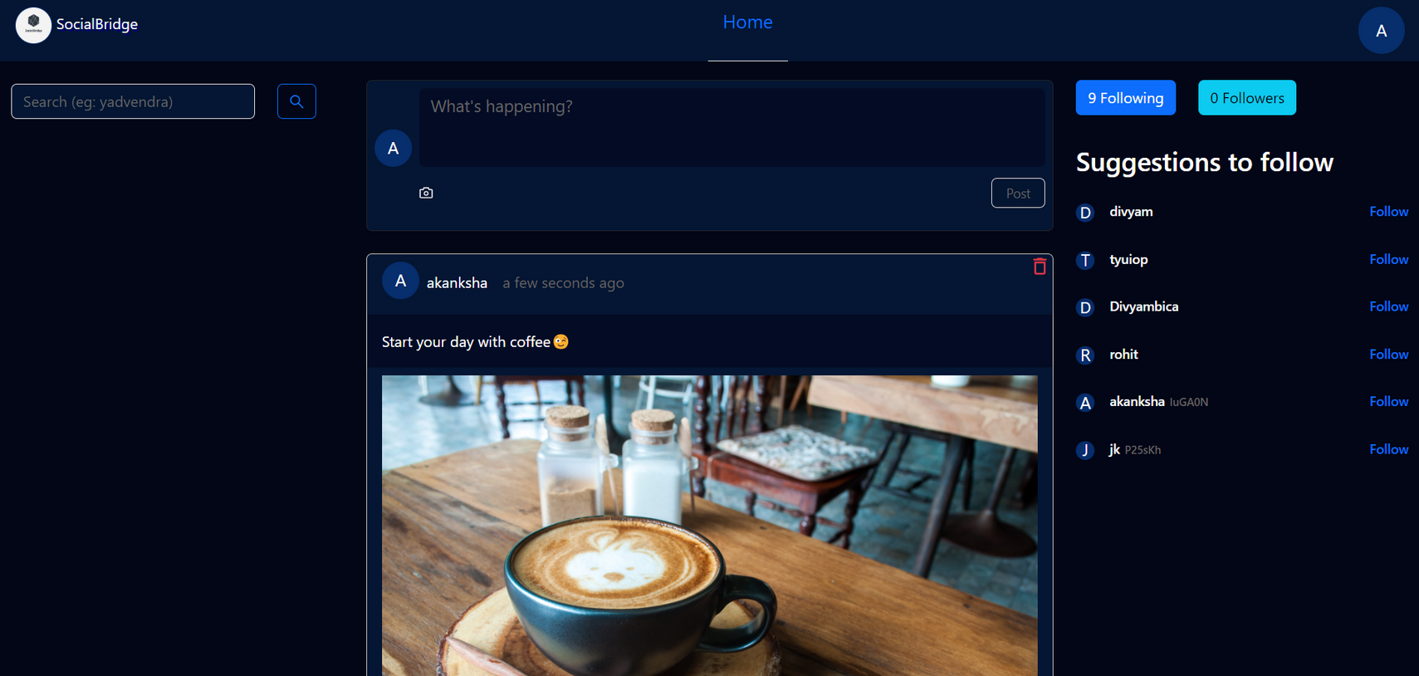
Home Page
19

Slide 20

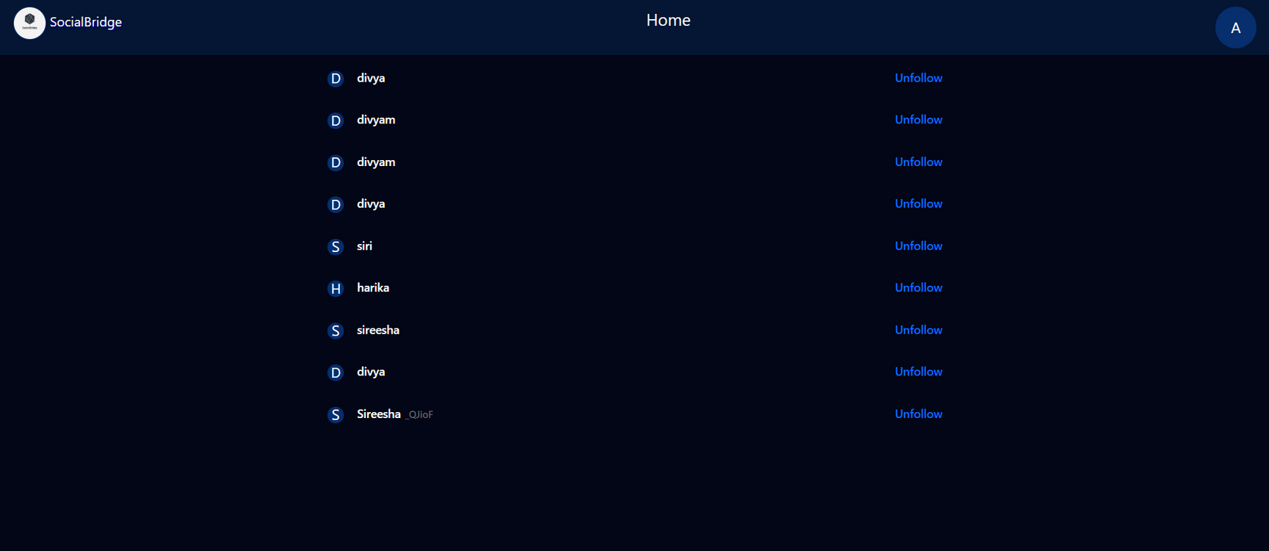
Followers Page
20

Slide 21

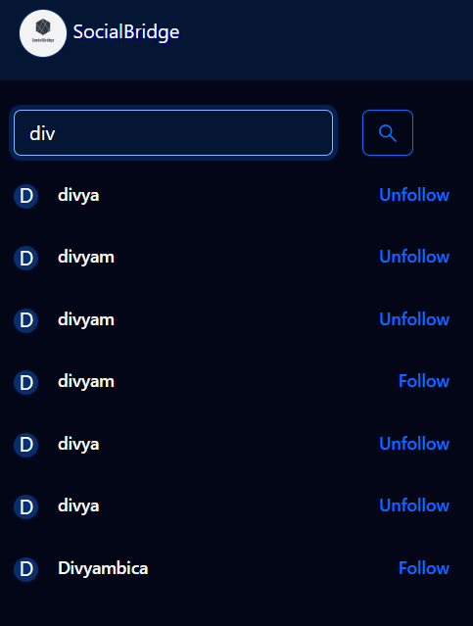
Search bar
21

Slide 22

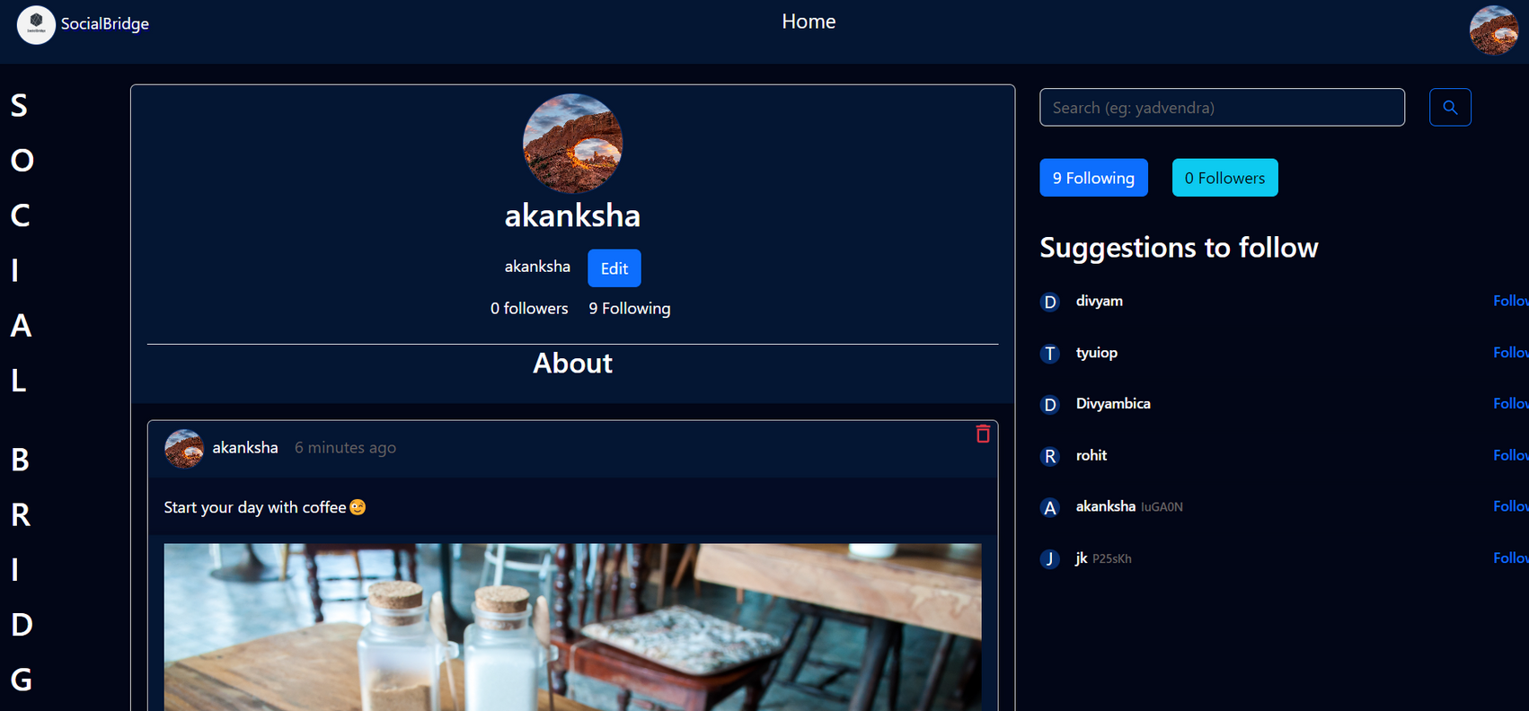
Profile Page
22

Slide 23

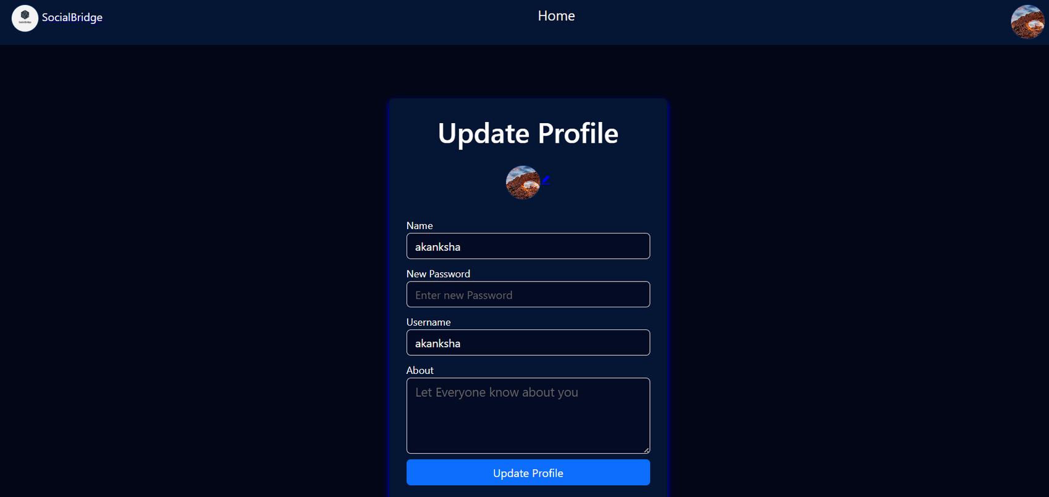
Update Profile
23

Slide 24

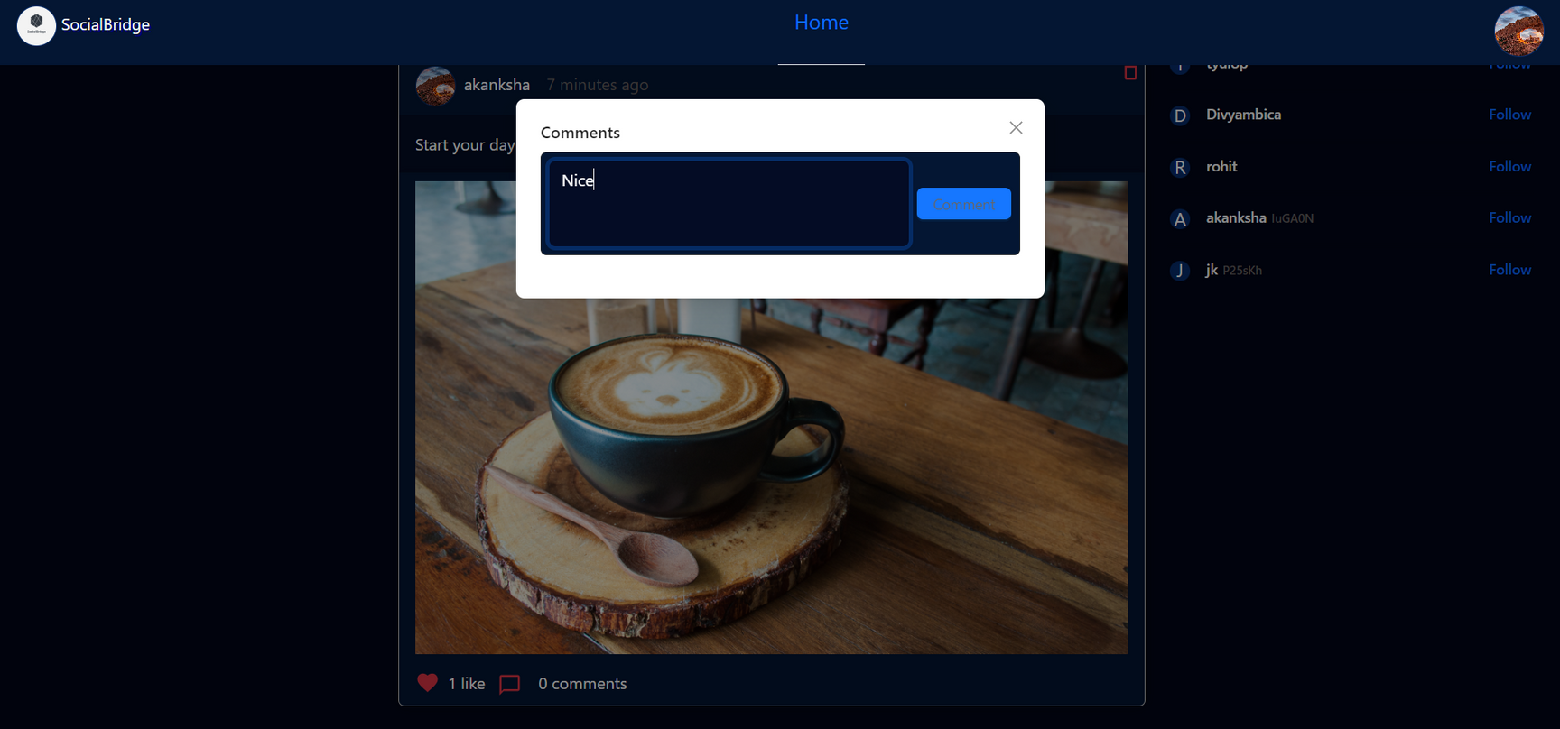
Comment Section
24

Slide 25
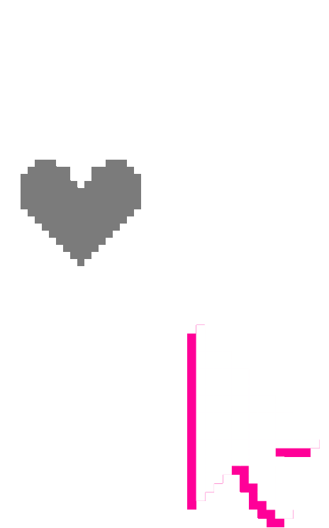
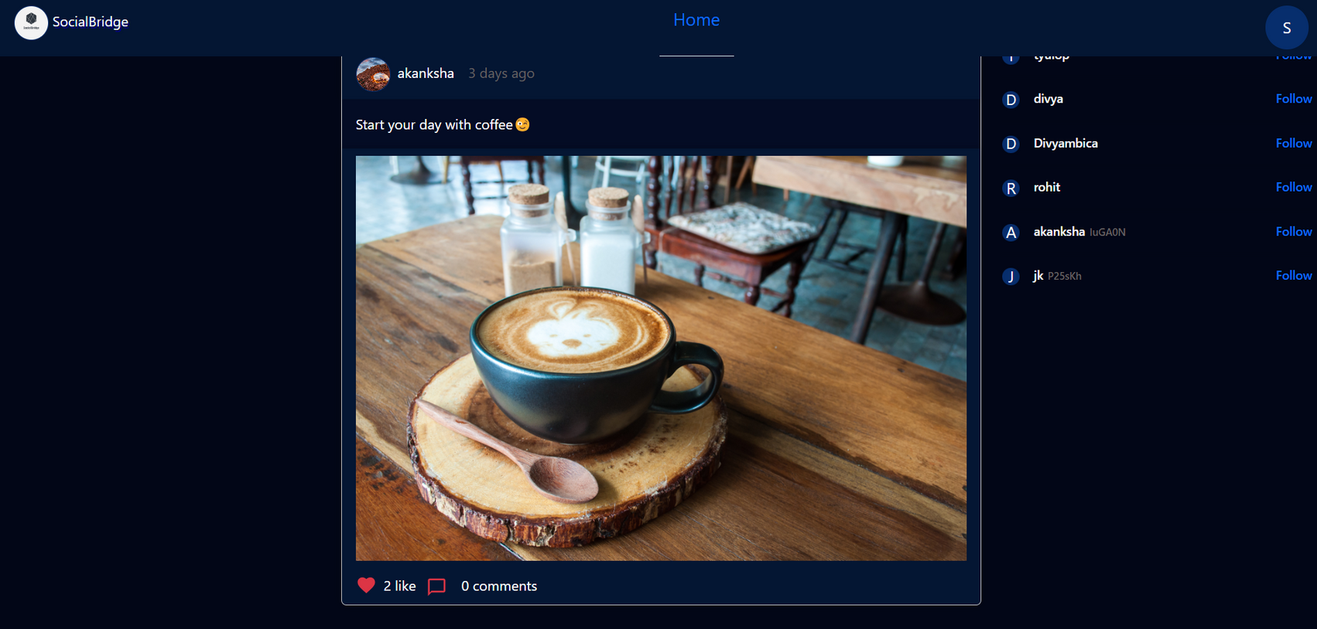
Likes
25

Slide 26
Conclusion
Embark on a revolutionary journey with our cutting-edge Social Media Application, meticulously crafted using the powerful MERN stack - MongoDB, ExpressJS, ReactJS, and NodeJS. Our platform redefines the realm of social interaction, offering an immersive experience that transcends boundaries and fosters meaningful connections.
Experience a seamless and intuitive interface that simplifies social networking. Our platform empowers users to connect with friends, share moments, and engage in vibrant discussions effortlessly. With innovative features and dynamic content discovery, every interaction is an opportunity to forge lasting connections.
26

Slide 27
Thank you very much!
27

